Slide 1

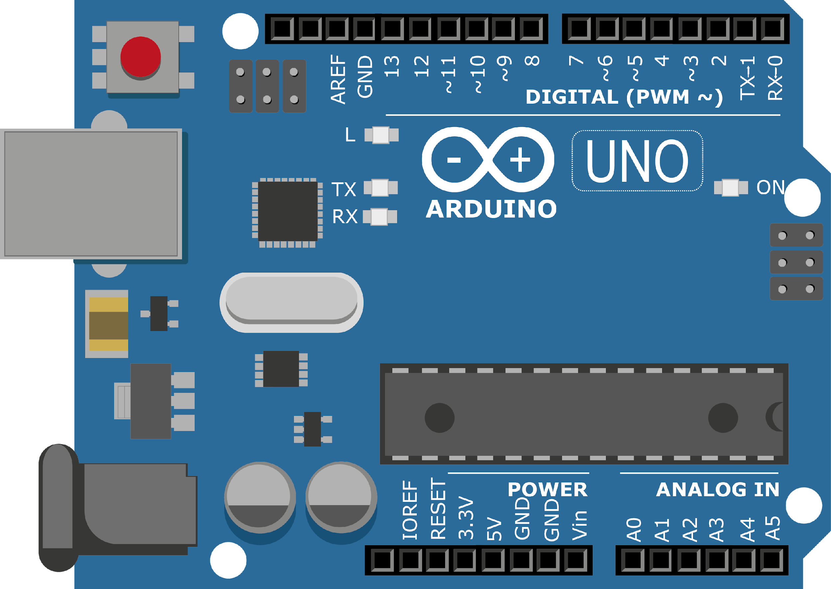
ARDUINO MASTER CLASS
01
Overview of Arduino & its Application

Slide 2
1 AGENDA
02
04
03
01
Applications
Embedded Systems
Course Overview
Arduino & other Microcontroller
What you will learn | Why you need to learn

Slide 3

PREREQUISITES FOR THIS COURSE
Laptop/PC
Arduino UNO with Cable ( or )
Arduino Master Class Kit (Optional)
No Basic Knowledge required

Slide 4
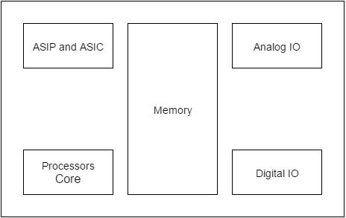
EMBEDDED SYSTEM
Embedded means something that is attached to another thing
An embedded system can be thought of as a computer hardware system having software embedded in it
An embedded system is a microcontroller or microprocessor based system which is designed to perform a specific task

Slide 5
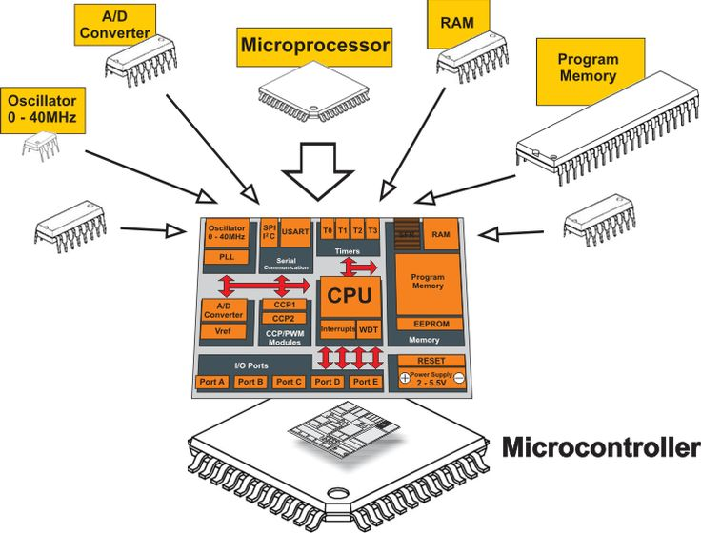
MICROPROCESSOR vs MICROCONTROLLER
MicroProcessor
MicroController
I/O Components & Memory need to be added externally
It has external processor along with I/O & intenal memory
Cannot be used in compact systems & Expensive
Used as compact systems & cost is low
It is based on Von Neuman model architecture, Program & Data stored in same Memory
It is based on Harvard model architecture, Program memory & Data memory are separate
Personal Computer
MP3 Player, Washing Machine etc.

Slide 6
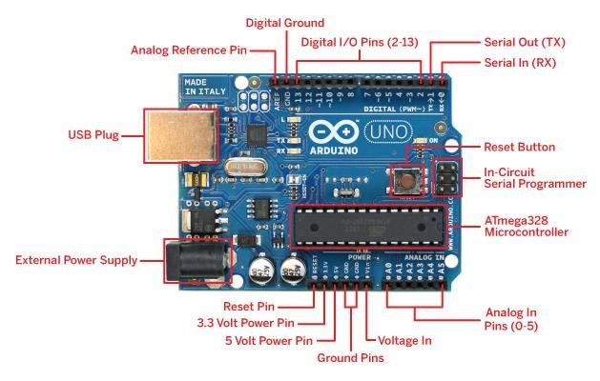
ARDUINO
Arduino is an open-source electronics platform based on easy-to-use hardware and software.
Arduino boards are able to read inputs - light on a sensor, activating a motor, turning on an LED, publishing something online.
You can tell your board what to do by sending a set of instructions to the microcontroller on the board.
To do so you use the Arduino programming language (based on Wiring), and the Arduino Software (IDE), based on Processing.

Slide 7

PROGRAMMING - MICROCONTROLLER
A microcontroller does not know what to do by itself. It’s your job to tell it what you want it to do.
Write program code on your computer
Compile the code with a compiler for the microcontroller you are using
Upload the compiled version of your program to your microcontroller

Slide 8
ARDUINO vs 8051
8051
Arduino
Modified Harvard Architecture-RISC(Reduced instruction set computing)
Harvard Architecture-CISC (Complex Instruction Set Computer).
Arduino houses 8-bit AVR microcontrollers. 32 bit development boards are also released
8051 is an 8-bit microcontroller. 16 and 32 bit are also available in market
Arduino boards can work on +5 volts to max 20 volts.
8051 operating voltage is between +5 volts to max 6.6 volts.
Arduino uno Flash Memory = 32 kB
Arduino uno RAM(Random Access Memory) = 2kB Arduino uno EEPROM= 1 kB
Flash Memory = 8 kB
RAM(Random Access Memory) = 256 Bytes
EEPROM= No eeprom
Clock Speed = 16 Mhz could be increase to 20 Mhz | ​One machine cycle = 1 clock cycle
Clock speed = 12 Mhz
​One machine cycle = 12 clock cycles

Slide 9
PROGRAMMING ARDUINO vs OTHER MICROCONTROLLER
Arduino
Other some MCU
Arduino Ide is used to write compile and upload code to the board.
A lay man can easily write code for Arduino in Arduino IDE. Its very simple and easy to understand.
In Arduino flash we can upload code by just connecting the board USBport with out computer/laptop and pressing the upload button in Arduino IDE. We do not need an external programmer. Arduino board has programmer built on it.
Generally keil Uvision IDE is used to write and compile code for microcontroller.
One has to know about the registers and pins definitions by compiler to write code for microcontroller.
To upload code in MCU flash we need an external programmer.

Slide 10

APPLICATIONS
Arduino Uno is used in Do-it-Yourself projects prototyping.
In developing projects based on code-based control
Development of Automation System
Designing of basic circuit designs

Slide 11

INTERVIEW QUESTIONS
Diff. b/w MicroProcessor vs MicroController
What is Embedded System ?
Explain Van Neuman & Harward Architecture

Slide 12

THANKS!

Slide 13

Q & A SESSION

